Slide 1
Prediction of optimum maturity of Sugarcane crop by using hand hold user (farmer) friendly digital tool/device.
CSE7302- Project
Review-2
Batch Number: CIT_30
Roll No | Name
20221CIT0052 | P Sajjan
20221CIT0035 | J Vamsi Krishna
20221CIT0048 | B Deekshitha
Under the Supervision of,
Guide : Ms.Pushpalatha M
Reviewer : Mr.Lakshmisha S. k
Name of the Program: CSE7302-project
Name of the HoD: Dr S P Anandaraj Sir
Name of the Program Project Coordinator:
Name of the School Project Coordinators: Dr. Sampath A K , Dr. Geetha A

Slide 2
Abstract:
Sugarcane maturity plays a vital role in determining sugar recovery, crop quality,
and farmer income. Harvesting too early results in low sucrose content, while
delayed harvesting leads to fiber increase and sugar loss. Traditional maturity
assessment methods rely on laboratory testing and visual inspection, which are time
consuming, costly, and not farmer-friendly. This project proposes a hand-held
digital tool/device that predicts the optimum maturity of sugarcane crops using real
time sensor data and intelligent analysis. The system integrates environmental
parameters, crop characteristics, and predictive models to provide simple harvesting
recommendations to farmers. This approach enhances decision-making accuracy,
reduces dependency on laboratories, and supports precision agriculture.

Slide 3
Objective:
To predict the optimum maturity stage of sugarcane crops
To design a hand-held, low-cost, and farmer-friendly digital device
To reduce dependency on laboratory-based maturity testing
To provide real-time harvesting recommendations
To improve sugar recovery and farmer profitability
To support sustainable and smart agriculture practices

Slide 4
Existing Methods and Drawbacks:
Visual Inspection: Subjective and varies between farmers
Laboratory Testing (Brix, Pol%): Costly, time-consuming, and not field-friendly
Manual Record Analysis: Requires expert knowledge and historical data
Weather-Based Estimation: Does not accurately reflect real crop physiology
Drawbacks:
Lack of real-time results
High operational cost
Not scalable for large farming areas
Limited accessibility for small and marginal farmers

Slide 5
Proposed Method and Feasibility:
Sensor Data Collection Collect real-time data such as temperature, humidity, soil moisture, and Brix value using field sensors.
Data Preprocessing Clean and normalize sensor data to remove noise and inconsistencies.
Feature Extraction Combine crop age, variety, and environmental parameters into meaningful features.
Maturity Prediction Model Apply machine learning or threshold-based logic to predict maturity stage.
Result Classification Categorize crop status into:
Immature
Near Maturity
Optimum Maturity
Output Display Display results on LCD or mobile app in simple farmer-friendly language.

Slide 6
Feasibility:
1. Technical Feasibility
The system uses low-cost sensors, microcontrollers (ESP32/Arduino), and basic machine learning models, which are easily available and reliable. The device can process data locally or communicate with a mobile application using Bluetooth/Wi-Fi, making the implementation technically practical.
2. Operational Feasibility
The hand-held device is designed to be simple and easy to use by farmers with minimal training. The system provides clear maturity results such as Immature, Near Maturity, or Ready to Harvest, making it suitable for real field conditions.
3. Economic Feasibility
The project involves low-cost hardware components and open-source software tools, keeping development and maintenance costs minimal. It reduces laboratory testing expenses and improves sugar recovery, resulting in higher farmer income and economic benefits.

Slide 7
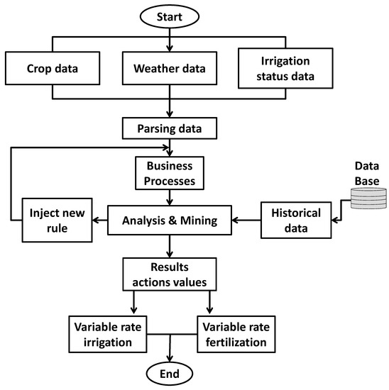
System Architecture:

Slide 8
System Modules:
Sensor Data Acquisition Module Collects temperature, humidity, soil moisture, and sugar indicators.
Data Preprocessing Module Cleans and normalizes raw sensor data.
Feature Extraction Module Selects relevant crop and environmental features.
Maturity Prediction Module Applies ML model or threshold logic to estimate maturity stage.
Decision Module Classifies maturity into Immature, Near Maturity, or Ready to Harvest.
Output & Notification Module Displays harvesting recommendation to farmers.

Slide 9
Hardware and Software details:
Software Requirements
Programming Language: Embedded C / Python
ML Libraries: Scikit-learn / TensorFlow
Development Tools: Arduino IDE
Mobile App: Android Studio / Flutter
Database: Firebase / MySQL
Optional: Cloud deployment tools

Slide 10
Hardware Requirements
Microcontroller: ESP32 / Arduino Uno
Sensors: Temperature, Humidity, Soil Moisture, Brix Sensor
Display: LCD / OLED
Communication: Wi-Fi / Bluetooth
Power Supply: Rechargeable Battery
Enclosure: Hand-held casing

Slide 11
Github Link

Slide 12
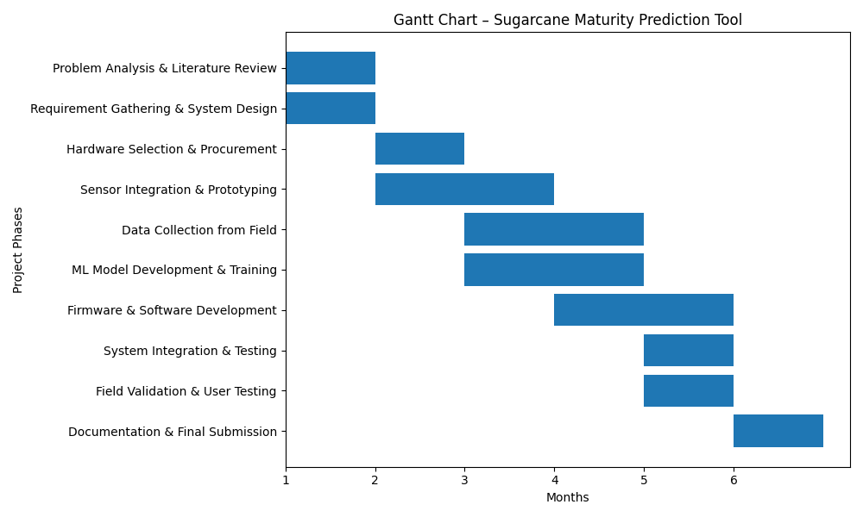
Timeline of the Project (Gantt Chart)

Slide 13
References (IEEE Paper format)

Slide 14


